Slide 1
OOAD
Introduction to OOD
Class Diagrams

Slide 2
class-Based Modeling
Allows us to extract classes and objects that the system will manipulate
Includes modeling of classes, objects, attributes, operations and class-responsibility-collaborator
Shows only the functional requirements of the system
Consists of guides that help in extracting classes
Iterative activity that makes extensive use of RE
Different literatures propose different activities and theories for this. Activity is guided by a set of criteria's that may be applicable for a certain application domain, but not favor another application domain

Slide 3
Identifying classes
Examine each requirement listed and underline noun or noun phrase
More classes surface from use case scenario.
Nouns should be further refined using the following selection characteristics, which will be used to disqualify or qualify the noun as a potential class:
  Retained information
  Needed services
  Multiple attributes
  Common attributes
  Common operations
  Essential requirements
For a class to be legitimate, it must satisfy all or almost all of the characteristics. Only 1 fail allowed
Notes:
Not all the nouns that have been underlined will qualify for classes, more filtration will need to be applied
Each noun identified should be weighed against the given characteristics for further refinement. A qualifying class should only fail at the most 1 characteristic.
Potential classes should be listed and rejected or accepted looking at the listed criteria’s.
One can come up with more classes if they have had a clear vision of how each scenario will operate

Slide 4
Characteristics explained
Retained Information – class will be useful only if information about it must be remembered so that the system can function
Needed Services – potential class must have a set of identifiable operations that can change the value of its attributes.
Multiple Attributes – potential class must have several attributes. Class with a single attribute is better represented as an attribute of another class
Common Attributes – a set of attributes can be defined for the potential class and these attributes apply to all the instances of the class.
Common Operations – a set of operations can be defined for the potential class and these operations apply to all the instances of the class
Essential Requirements – external entities that appear in the problem space and produce/consume information to the operation of any solution for the system will almost be defined as class
Notes:
Retained information- eg if several requirements make use of information from a class that has been identified as a potential class
Common attributes ie attributes must be applicable to all instances of that class, not just one instance. A potential class should not only consist of static attributes, but rather instance attributes
Common operations ie should consist of instance operations not just static operations
Essential requirements- any entity that produces or consumes data for the realization of an essential requirement will be defined as a class

Slide 5
Types of classes
Entity Classes – classes that represent things that are to be stored in the database. Derived from the problem statement eg floor plan, sensor, bullet etc
Boundary Classes – create the interfaces that the user sees and interacts with. Created to manage the way entity objects are presented to users eg interactive screen or printed report or board in a game or communication protocol class
Controller Classes – manage a unit of work from start to finish. They can be designed to manage the following:
  The creation or update of entity objects
  The instantiation of boundary classes as they obtain information from entity classes
  Complex communication between sets of objects
  Validation of data communicated between objects or between the user and the application
Notes:
Not all classes can be derived simply by looking for nouns. Other classes can be derived by considering types of classes that normally exist in an application. More classes will be derived by taking the following class types into consideration.
These class types will normally surface from requirement scenarios

Slide 6
Example classes: Hotel Management
Boundary Classes
  Manager-Reservation-behavior
  Customer-Reservation-behavior
Control Classes
  Make Reservation
  Group Reservation
  Corporate Reservation
Entity Classes
  Customer information
  Room information
  Reservation information
Notes:
Hotel Management system in which customer can make reservations. The following analysis classes could be derived

Slide 7
Attributes & Operations
Attributes store data that exclusively belong to a class
Their data type might be explicitly stated in the requirements
Operations define the behavior of an object
Operations category
  Operations that manipulate data in some way
  Operations that perform computations
  Operations that inquire about the state of an object
  Operations that monitor an object for the occurrence of controlling event

Slide 8
Class-Responsibility-Collaborator Modeling
Acts as another means of identifying and organizing classes relevant to the system
Consists of a collection of standard index cards representing classes
Cards have 3 main sections
  Top part – for class name
  Body Left – for listing class responsibility
  Body Right – for listing collaborators

Slide 9
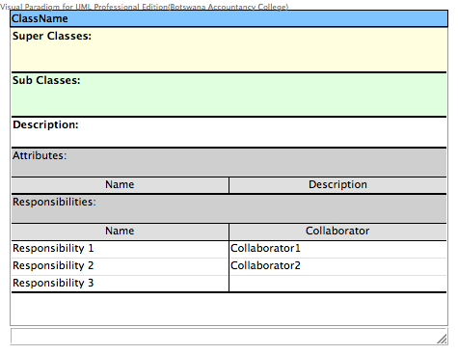
eg of CRC

Slide 10
CRC
Responsibilities
  Attributes and operations that are relevant for the class
  Anything the class knows or does
Collaborators
  Classes required to provide a class with the information needed to complete a responsibility
  Must be listed next to the responsibility they are associated with

Slide 11
Class Diagrams
The most widely used diagram of UML
Models the static design view of the system
Used to specify the structure, interfaces and relationships between classes that underlie the system architecture
Primary diagram for generating codes from UML models
Notes:
Once classes have been defined, one has to model them using class diagrams

Slide 12
Class compartments
A class is comprised of three sections
  The first section contains the class name
  The second section shows the structure (attributes)
  The third section shows the behavior (operations)
Class Name
Professor
name
Attributes
empID
Operations
create( )
save( )
delete( )
change( )

Slide 13
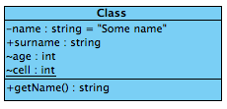
CD Attributes
Used to specify the data fields/members of an object
Must have a data type & visibility
Naming convention is similar to naming variables
Visibility modifiers:
  + -> public data field
  - -> private data field
  ~ -> protected data field
Underlined attributes are normally static

Slide 14
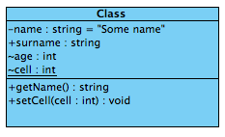
CD Operations
Specifies the behavior found in objects
Translates to method/functions/subroutines/procedures in code
May have a return type, parameters, modifiers etc
Naming convention similar to the ones in your programming language

Slide 15
Stereotypes
A mechanism for extending the semantics of UML
Used to represent more information about an artifact
The name of the new element is placed within the matched guillemets <<>> eg <<thread>>
Notes:
Stereotypes are a way of adding more information to class diagrams

Slide 16
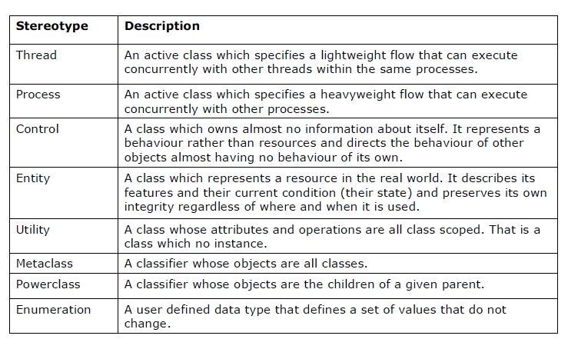
Common stereotypes used with classes

Slide 17
CD Relationships
Associations
Aggregation
Generalization
Composition
Notes:
Shows the relations between classes.

Slide 18
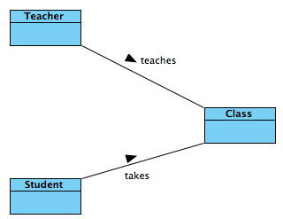
Association
Models a connection among classes
Shows that one object is aware of the existence of another
Association normally happens in a particular direction
Name given is normally verbs
Interpretation
Teacher teaches a class
Student takes a class
Notes:
Interpretation – show how the relationships are normally interpreted from the diagram
Notice that the interpretation must be done in a certain direction for the association to make sense
Direction is crucial as it it adds sense to the association
Association must have a label to clarify the nature of the association

Slide 19
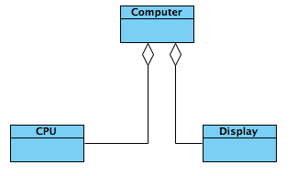
Aggregation
Used to illustrate the whole-part relationship between two classes where one class is considered a whole, made up of one or more classes comprising its parts.
Has an empty diamond at the class representing the whole
Notes:
Computer is the whole class. Cpu & Display are part class

Slide 20
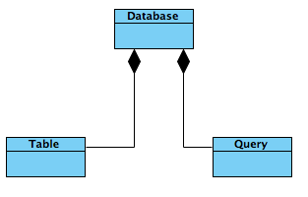
Composition
Another type of aggregation, in which the part classes used to make the whole class cannot exist on their own
The part classes need the whole class to exist
Destroying the whole class destroys the part class
Uses a solid diamond at the whole class end of line
Notes:
Interpretation: whole database class consists of both tables and queries

Slide 21
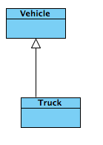
Generalization
Type of a relationship between a more general class and a specific class.

Slide 22
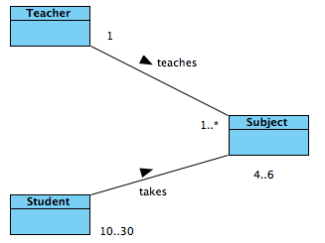
Multiplicity
Shows how many objects of one class are related to objects of another class
Can be added on either side of class relationship
Normally shown by a single number or a range of numbers
Student takes 4-6 Subjects
Subject has 10-30 students
1 teacher takes 1 or many subjects
Notes:
Multiplicity alerts the programmer that they will need to use some sort of array syntax to hold the group of references

Slide 23
Association: Multiplicity
Unspecified
Exactly one
Zero or more (many, unlimited)
One or more
Zero or one
Specified range
Multiple, disjoint ranges
0..*
1..*
0..1
2..4
2, 4..6

Slide 24
Example scenario
Example scenario and finding classes from the scenario

Slide 25
References
S/W Engineering, A practitioners approach, Roger S Pressman. Chapter 6
More reading from UML Bible, chapter 6

